Slide 1
Observation & Remote Sensing
CGPRT(W) : Ensuring Clean Seas and Coasts in Western Region ……

Slide 2
Objectives
To understand why observation is an integral/ essential element of spill response
To recognize what platforms may be available to you in the command centre
To understand the requirements for flight planning
To understand how to carry out visual observations
To understand how to quantify oil at sea
CGPRT(W) : Ensuring Clean Seas and Coasts in Western Region ……

Slide 3
Introduction
Observation is a key element in an effective response.
It enables us to:
Assess the location and extent of the pollution
Verify predictions of the movement and fate of oil at sea
Interpret information to facilitate the deployment and control of operations at sea
Identify threatened shorelines enabling protection of sites and the preparation of shoreline response.
CGPRT(W) : Ensuring Clean Seas and Coasts in Western Region ……

Slide 4
Initial Spill Assessment
Overflights should be a high priority in the initial stages of a response
The information we require for response strategy is:
Confirm spill source/location and size
Identify oil type and condition
Identify local weather conditions and sea state
Corroborate forecasted spill trajectory
Identify potential areas at risk
CGPRT(W) : Ensuring Clean Seas and Coasts in Western Region ……

Slide 5
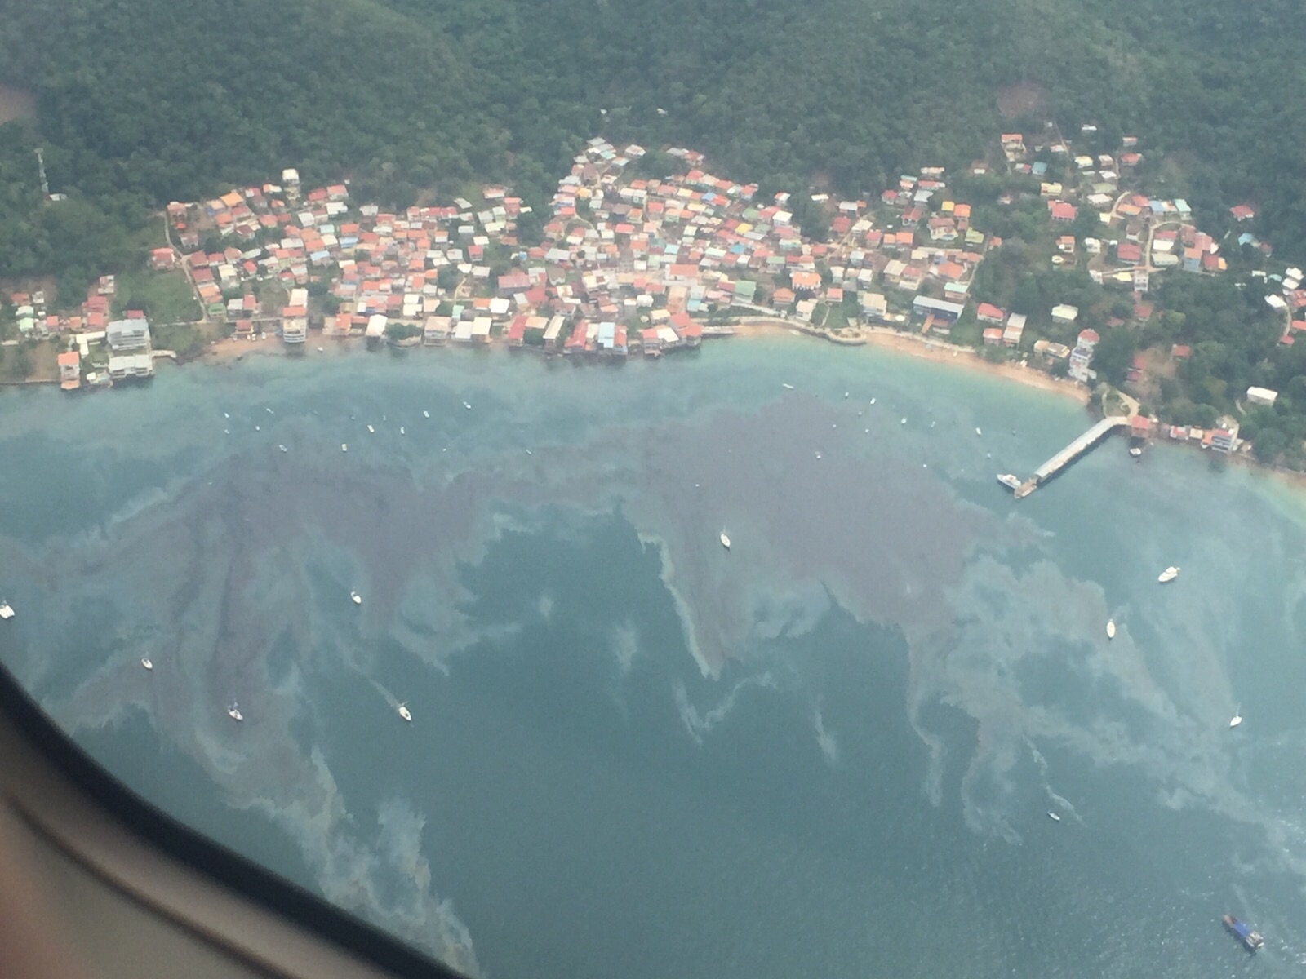
Initial Spill Assessment
CGPRT(W) : Ensuring Clean Seas and Coasts in Western Region ……

Slide 6
Spill Observation
The tools we have depend on local resources and availability but could include:
Untrained observers
Vessels, installations or ports-trained observers
Aircraft with trained observers and portable equipment
Dedicated remote sensing aircraft
Unmanned surveillance platforms
Satellite imagery
Subsea sensors
CGPRT(W) : Ensuring Clean Seas and Coasts in Western Region ……

Slide 7
Untrained Observers
Untrained spotters
Passing vessels
Overflying aircraft
Local fishermen and public
It may be the first indication you receive of a pollution incident
Their reports, especially location, size, colours and smell can be very useful
Use a proforma pollution report to debrief the observer
CGPRT(W) : Ensuring Clean Seas and Coasts in Western Region ……

Slide 8
Trained Observers
Trained observers will be used to observing and quantifying reports
They will provide more reliable depth with a higher confidence factor
They can compile observation reports and may provide photographic evidence
Their “height of eye” may be limited thus restricting their visual range
CGPRT(W) : Ensuring Clean Seas and Coasts in Western Region ……

Slide 9
Aircraft and Trained Observers
Often the most frequently available platforms
High-mounted wings offer good all-round visibility
Twin-engines are essential over water
Navigational aids, communications and endurance are important for long-range missions
Helicopters offer flexibility for near-shore missions especially for surveying intricate coastlines
CGPRT(W) : Ensuring Clean Seas and Coasts in Western Region ……

Slide 10
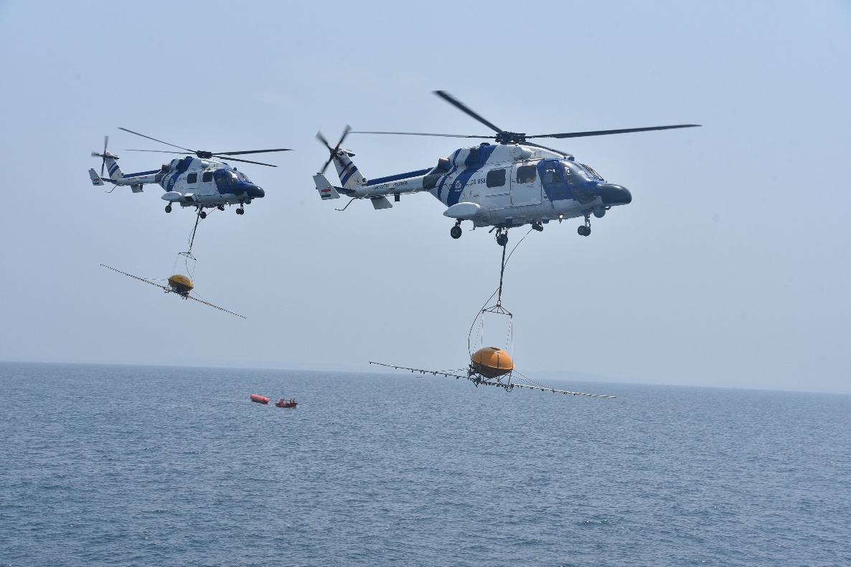
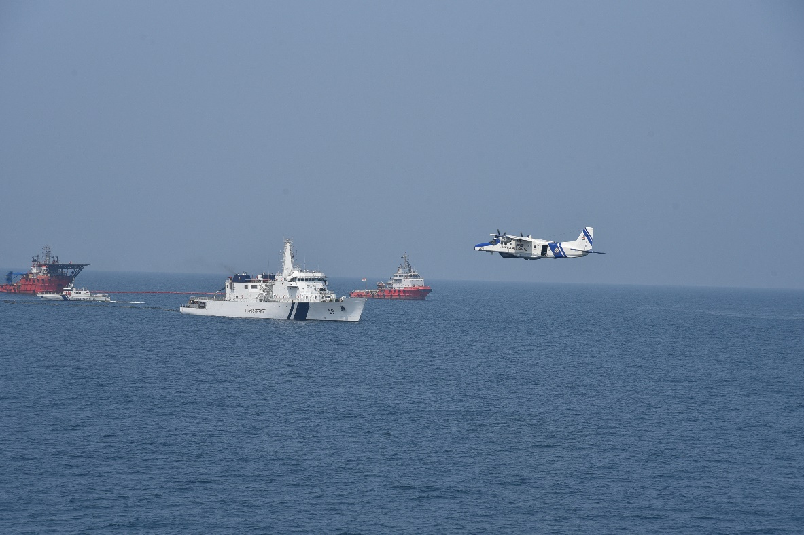
Aircraft and trained observers
Source: OSRL
CGPRT(W) : Ensuring Clean Seas and Coasts in Western Region ……

Slide 11
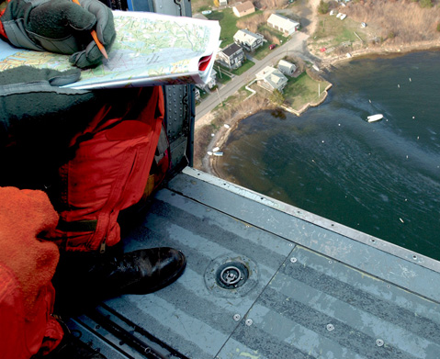
Trained Observers
CGPRT(W) : Ensuring Clean Seas and Coasts in Western Region ……

Slide 12
Remote Sensing Aircraft
Routinely used to detect, monitor and identify illegal marine discharges in a “patrolling” role
Can be used to respond to marine oil spills
Can be used to provide aerial command and control for at-sea operations
Fitted with highly-trained and experienced observers and specialist remote sensing equipment
Generally government owned/contracted
CGPRT(W) : Ensuring Clean Seas and Coasts in Western Region ……

Slide 13
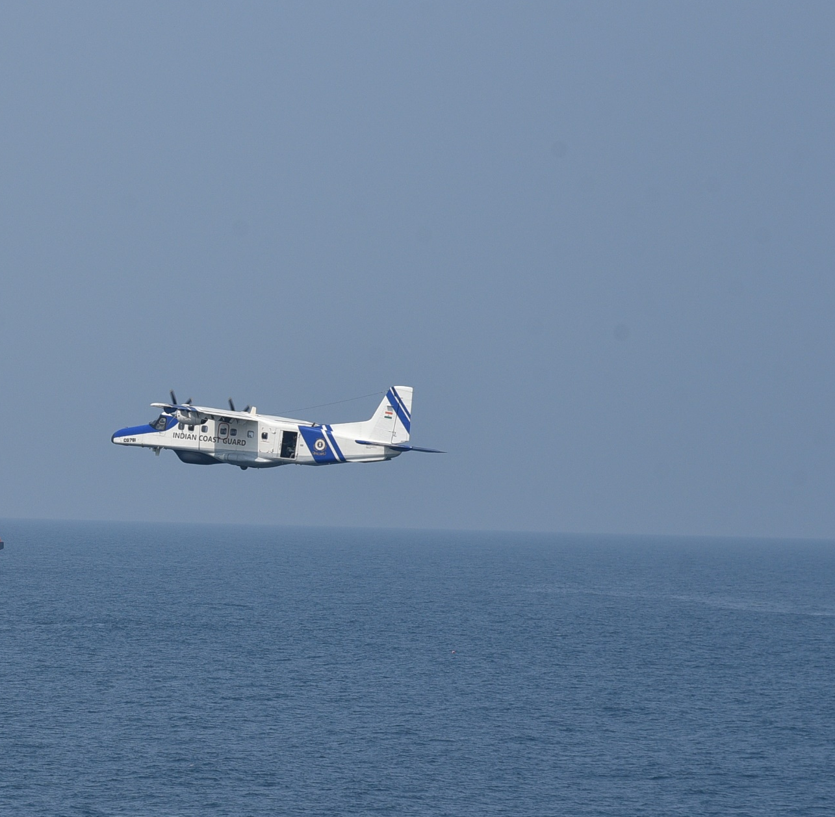
Remote Sensing Aircraft
CGPRT(W) : Ensuring Clean Seas and Coasts in Western Region ……

Slide 14
Remote Sensing Aircraft
The most commonly employed sensors include:
Side-looking Airborne Radar (SLAR)
Downward-looking thermal Infra-Red (IR)
Ultra-Violet (UV) imaging systems
Other systems include:
Forward-Looking Infra-Red (FLIR)
Microwave Radiometers (MWR)
Laser Flurosensors (LF)
Compact Airborne Spectrographic Imagers (CASI)
CGPRT(W) : Ensuring Clean Seas and Coasts in Western Region ……

Slide 15
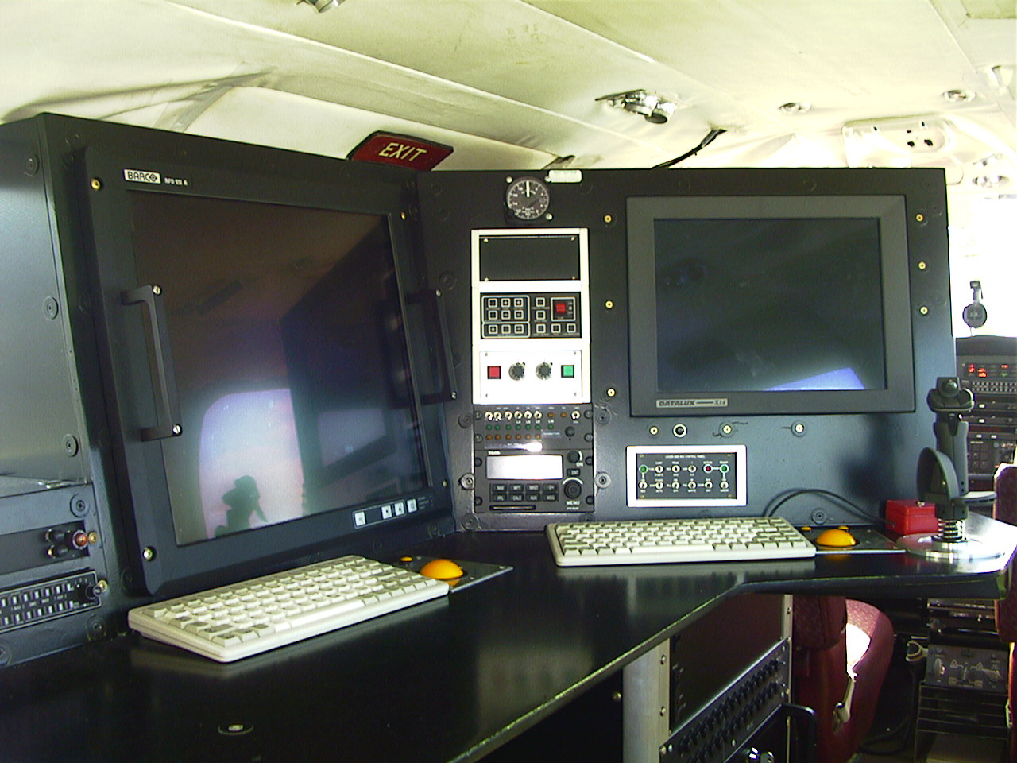
Remote Sensing
Source: Maritime and Coastguard Agency
CGPRT(W) : Ensuring Clean Seas and Coasts in Western Region ……

Slide 16
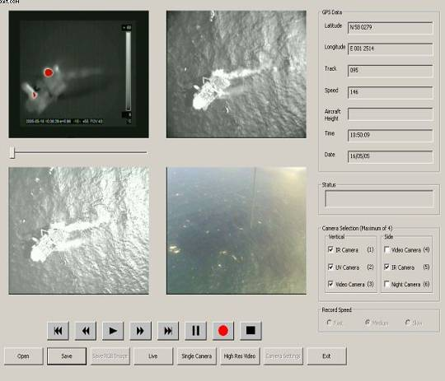
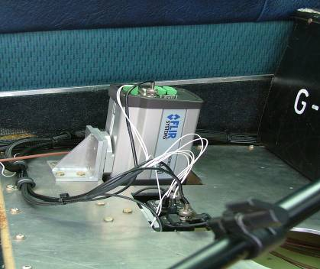
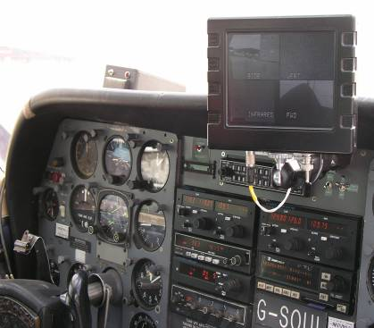
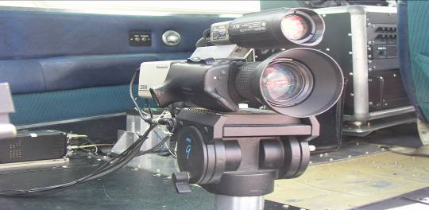
CGPRT(W) : Ensuring Clean Seas and Coasts in Western Region ……

Slide 17
Remote Sensing
Sensor | Coverage | Day | Night | Cloud cover, fog , haze, rain
SLAR | Wide area | Yes | Yes | Yes
Thermal IR | Narrow | Yes | Yes | No
UV | Narrow | Yes | No | No
FLIR | Narrow | Yes | No | No
MWIR | Wide Area | Yes | Yes | Possibly
LF | Narrow | Yes | Yes | No
CASI | Narrow | Yes | No | No
Combined SLAR and IR/UV systems have been used fairly widely during oil spills.
CGPRT(W) : Ensuring Clean Seas and Coasts in Western Region ……

Slide 18
Unmanned Aerial Systems
Relatively new but fast-growing market
Generally comprised of:
Unmanned aerial platform with sensors
Communications system
Ground control station
Sizes range from backpack portability to large systems requiring large vehicle transportation
Regulatory environment currently being developed
CGPRT(W) : Ensuring Clean Seas and Coasts in Western Region ……

Slide 19
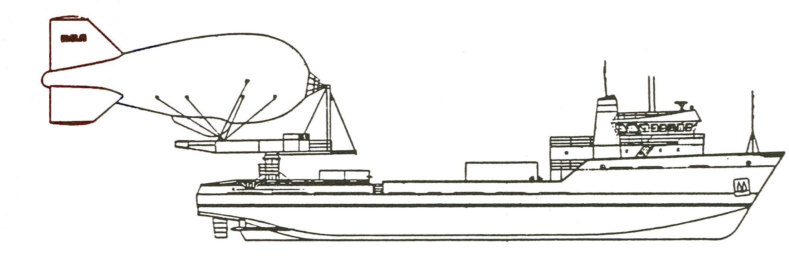
Unmanned Aerial Systems
Aerostat – tethered ballons
CGPRT(W) : Ensuring Clean Seas and Coasts in Western Region ……

Slide 20
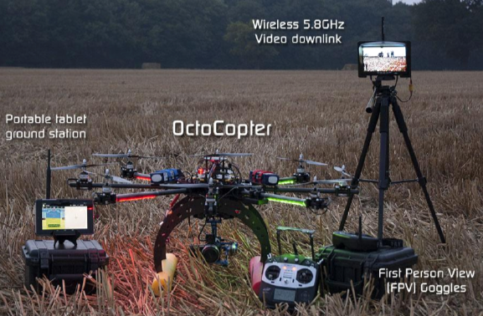
Unmanned Aerial Systems
CGPRT(W) : Ensuring Clean Seas and Coasts in Western Region ……

Slide 21
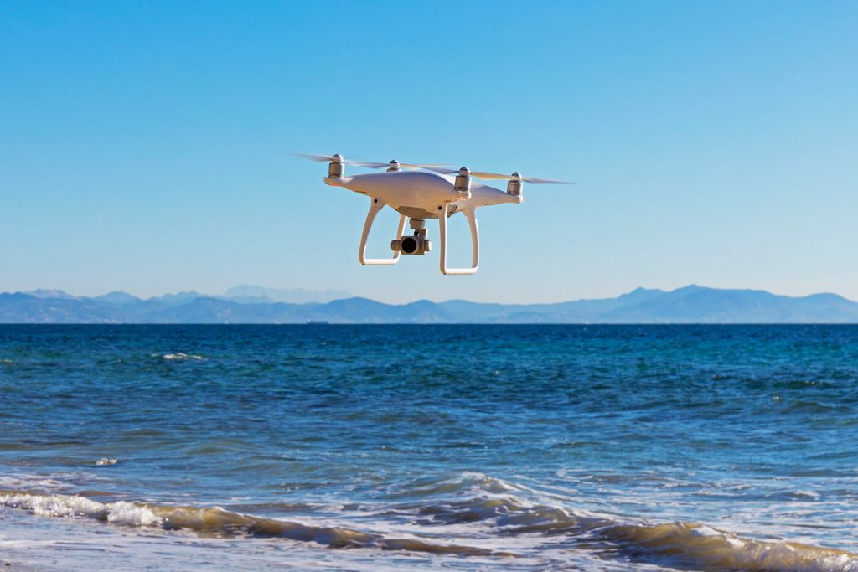
Unmanned Aerial Systems
CGPRT(W) : Ensuring Clean Seas and Coasts in Western Region ……

Slide 22
Satellite Sensors
Satellite-based sensors can detect oil on water
Sensors used include those operating in the visible and infra-red spectrum and Synthetic Aperture Radar (SAR)
SAR is not limited by daylight or clouds
SAR imagery can provide a lot of “false positives” and needs interpretation and on-scene corroboration
CGPRT(W) : Ensuring Clean Seas and Coasts in Western Region ……

Slide 23
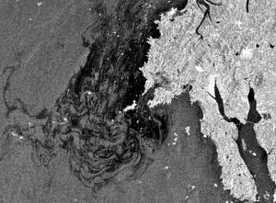
Satellite Imagery
Advanced Synthetic Aperture Radar (ASAR) satellite image of the eastern Yellow sea 3.5 days after the HEBEI SPIRIT. Image provided by ESA.
CGPRT(W) : Ensuring Clean Seas and Coasts in Western Region ……

Slide 24
Imagery
The raw data captured by the sensors can result in huge volumes of electronic media
This media needs to be stored, analysed and distributed in a manner that can be used by decision-makers and planners
Linking the imagery with any modelled outputs is very useful
Timely analysis and distribution to the end users is critical if the imagery is to be effective
CGPRT(W) : Ensuring Clean Seas and Coasts in Western Region ……

Slide 25
Subsea Sensors
There are a range of oil detection sensors and oceanographic vehicles that can be used to track and detect oil in water.
Vehicles include:
Autonomous underwater vessels (AUVs)
Autonomous surface vehicles (ASVs)
Remotely operated vehicles (ROVs)
Manned surface vessels
Typically these are employed by the scientific research communities, offshore industry and the military
CGPRT(W) : Ensuring Clean Seas and Coasts in Western Region ……

Slide 26
Subsea Sensors
The sensors include:
Ultra-Violet (UV)
Visible
Thermal Infra-red (IR)
Radar
Fluorescence LIDAR
The most frequent usage in oil spill response is with fluorometers to measure the efficiency of dispersant operations
Other uses may include wreck survey and monitoring
CGPRT(W) : Ensuring Clean Seas and Coasts in Western Region ……

Slide 27
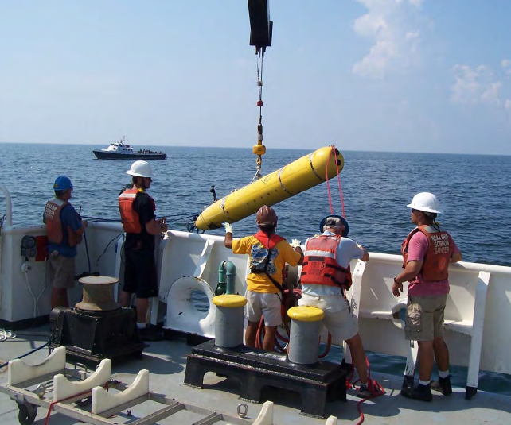
AUV
AUV being deployed from NOAA research vessel near the Deepwater Horizon incident site
Source: IPIECA JIP
CGPRT(W) : Ensuring Clean Seas and Coasts in Western Region ……

Slide 28
Aerial observation of oil at sea
CGPRT(W) : Ensuring Clean Seas and Coasts in Western Region ……

Slide 29
Minimum Operating Requirements
The minimum requirements for aircraft are:
Compliance with local and international aviation regulations (and associated certification)
Supplemental Type Certificates (STC) that allow an operator to install and operate a given sensor
Flight permissions
Flight plan
Good downward visibility
Slow speed capability
CGPRT(W) : Ensuring Clean Seas and Coasts in Western Region ……

Slide 30
Minimum Operating Requirements
The minimum requirements for aircraft (contd)
Effective communications with vessels and ground
Trained and equipped personnel for operating the platform and sensors and /or making manual spill observations
Sensor suite incorporating a minimum of digital camera/video with positional information and data link to control centre
High accuracy dynamic positioning system integrated with sensor suite
CGPRT(W) : Ensuring Clean Seas and Coasts in Western Region ……

Slide 31
Flight Planning
Weather conditions such as fog, mist, low cloud, snow and heavy rain can affect surveillance
High winds may mean flying is impractical
A flight plan should be prepared in advance, agreed with the pilot and the command centre taking into account visibility, altitude, direction of sun, flight duration, fuel availability and communications
Flights should be planned from start to finish allowing sufficient light for observation
CGPRT(W) : Ensuring Clean Seas and Coasts in Western Region ……

Slide 32
Flight Planning
Observations should be recorded on a proforma observation log with photographs and video linked to GPS.
Fast shutter speeds (1/500th second) are recommended.
Haze and light reflection can affect visibility. Positioning the sun behind the observer is easiest.
Polarizing sunglasses can assist under certain light conditions.
CGPRT(W) : Ensuring Clean Seas and Coasts in Western Region ……

Slide 33
Incident Management
Command Function
Planning Function
Logistics
Function
Finance Function
Operations Function
Data
Observation
CGPRT(W) : Ensuring Clean Seas and Coasts in Western Region ……

Slide 34
Visual Quantifying Oil at Sea
CGPRT(W) : Ensuring Clean Seas and Coasts in Western Region ……

Slide 35
Visual Quantifying Oil Volumes
Accurate assessment of quantity is not possible due to difficulties in assessing the thickness and coverage of the oil.
The Bonn Agreement Oil Appearance Code describes the relation between the appearance, thickness and volume of floating oil.
CGPRT(W) : Ensuring Clean Seas and Coasts in Western Region ……

Slide 36
Bonn Agreement Oil Appearance Code
Code | Appearance | Approximate thickness (μm) | Litres per km²
1 | Sheen (silvery/grey) | 0.04 – 0.30 | 40 - 300
2 | Rainbow | 0.3 – 5.0 | 300 – 5,000
3 | Metallic | 5.0 – 50 | 5,000 – 50,000
4 | Discontinuous True Oil Colour | 50 – 200 | 50,000 – 200,000
5 | Continuous True Oil Colour | 200 + | 200,000 +
Estimation of range (upper and lower figures)
CGPRT(W) : Ensuring Clean Seas and Coasts in Western Region ……

Slide 37
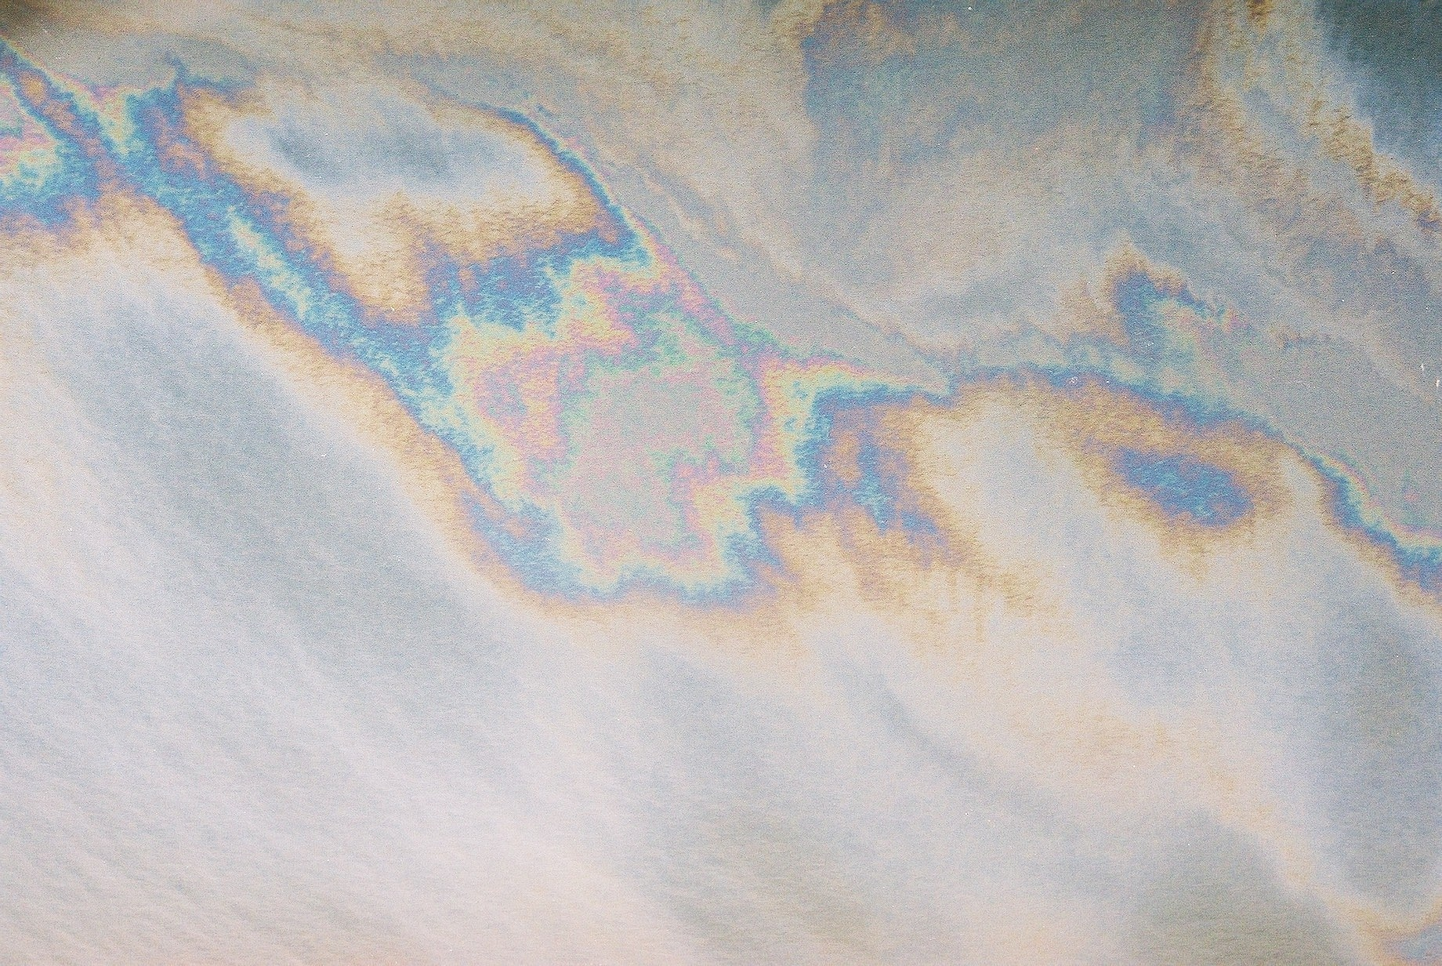
Code 1 – Sheen/Code 2 − Rainbow
CODE 1 ‘SHEEN’ + CODE 2 ‘RAINBOW’
Source: Bonn
CGPRT(W) : Ensuring Clean Seas and Coasts in Western Region ……

Slide 38
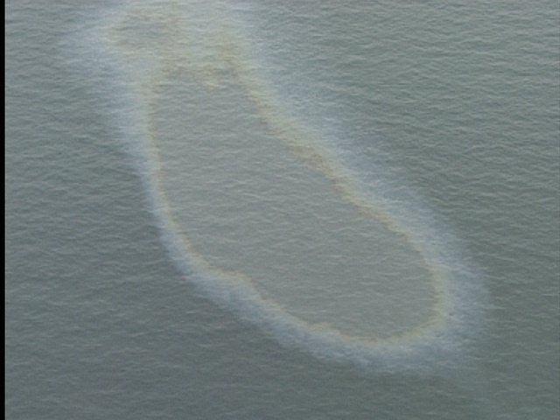
Code 3 - Metallic
Code 3 ‘Metallic’ appears as a homogeneous colour. It acts like a ‘mirror’ that is dependent on light and sky conditions. When the sky is ‘blue’ – the colour blue will be observed.
Source: Bonn
CGPRT(W) : Ensuring Clean Seas and Coasts in Western Region ……

Slide 39
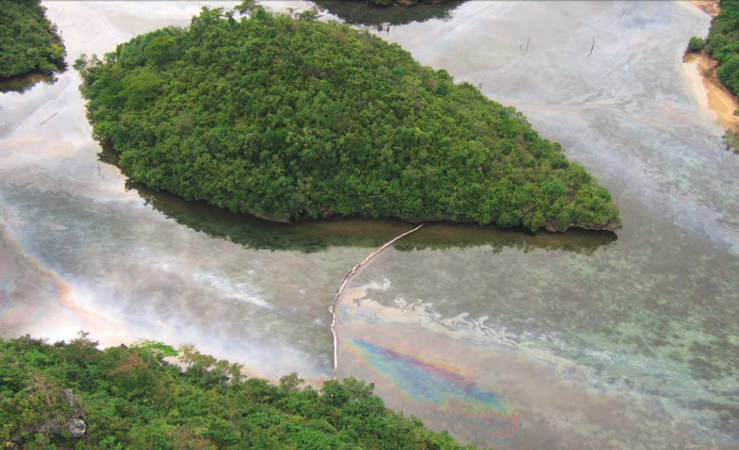
Sheen, Rainbow and Metallic
Source: ITOPF
CGPRT(W) : Ensuring Clean Seas and Coasts in Western Region ……

Slide 40
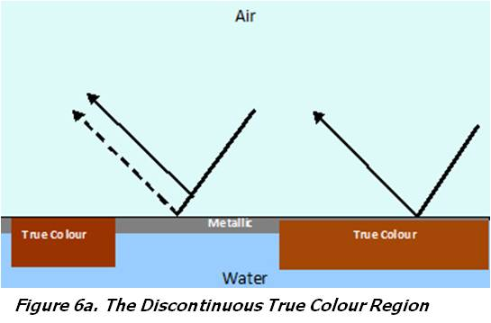
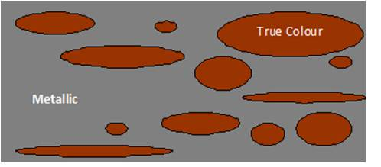
Discontinuous True Colour
50 μm to 200 μm
Code 4 – Discontinuous true colour − consists of small areas, or patches, of Code 5, Continuous true colour in a background of Code 3, Metallic.
Source: Bonn
CGPRT(W) : Ensuring Clean Seas and Coasts in Western Region ……

Slide 41
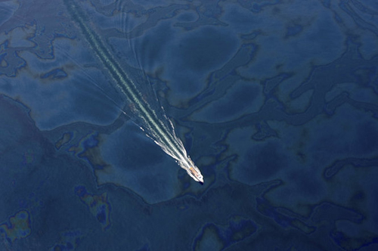
Discontinuous True Colour
Source: Bonn
CGPRT(W) : Ensuring Clean Seas and Coasts in Western Region ……

Slide 42
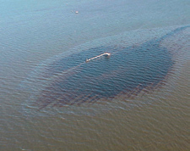
Continuous True Colour
200 μm +
CODE 5
Source: Bonn
CGPRT(W) : Ensuring Clean Seas and Coasts in Western Region ……

Slide 43
Continuous True Colour
200 μm +
CODE 5 − CTC
Source: Bonn
CGPRT(W) : Ensuring Clean Seas and Coasts in Western Region ……

Slide 44
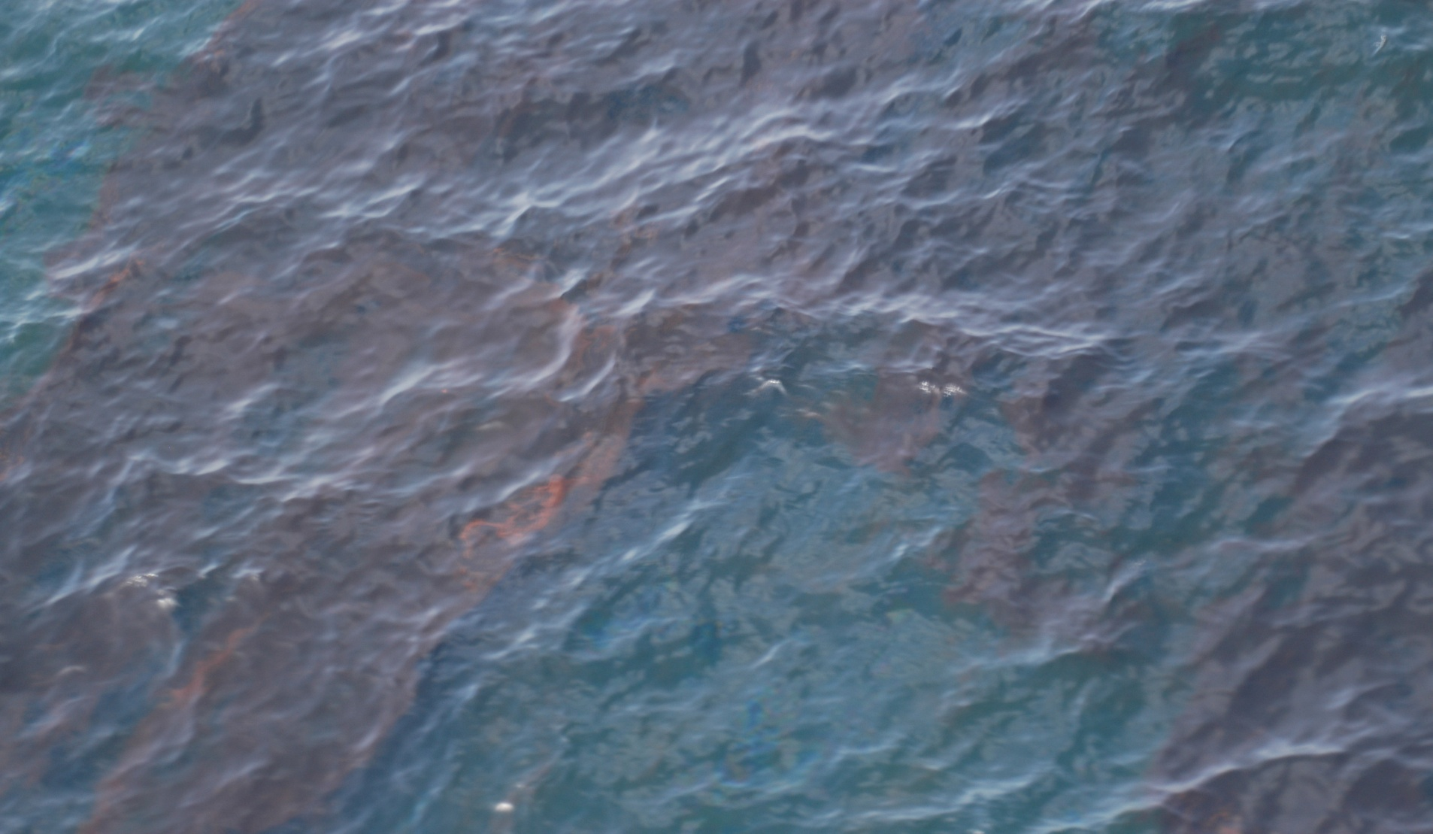
Continuous True Colour
Source: Bonn
CGPRT(W) : Ensuring Clean Seas and Coasts in Western Region ……

Slide 45
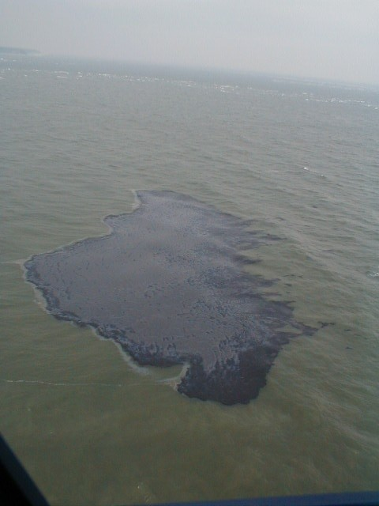
Continuous True Colour
HEAVY FUEL OIL
Source: Bonn
CGPRT(W) : Ensuring Clean Seas and Coasts in Western Region ……

Slide 46
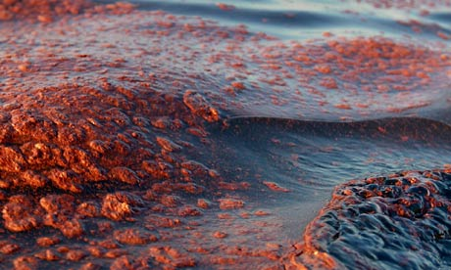
Water in Oil Emulsification
Emulsified oil can range in colour from dark brown to almost red or tan and typically has a “thickened” or “pudding-like” consistency compared to freshly spilled oil.
The incorporation of up to 80% water into the oil will cause the apparent volume of a given quantity of oil to increase four times.
Source: Bonn
CGPRT(W) : Ensuring Clean Seas and Coasts in Western Region ……

Slide 47
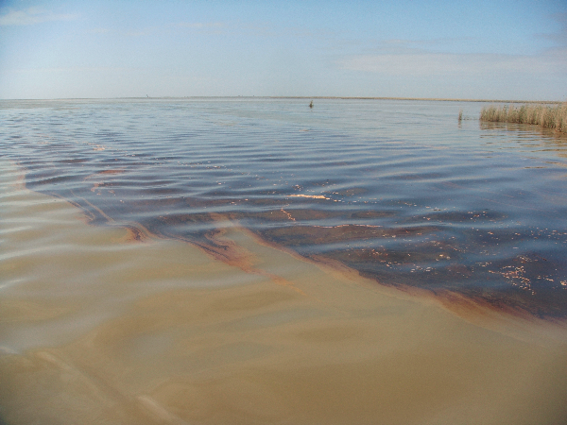
Emulsified Oil
Emulsified crude oil accumulated against a salt marsh by an onshore wind. The wedge of oil formed in this way can be several cm thick.
Source: NOAA
CGPRT(W) : Ensuring Clean Seas and Coasts in Western Region ……

Slide 48
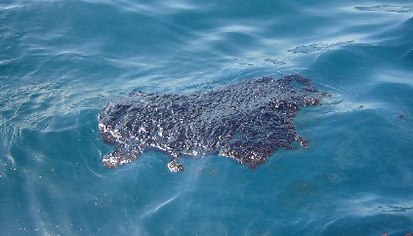
Oil Pancakes
Isolated patches of roughly circular shaped oil that range in size from around a metre to hundreds of metres in diameter become pancakes. Sheen may or may not be present.
Source: Bonn
CGPRT(W) : Ensuring Clean Seas and Coasts in Western Region ……

Slide 49
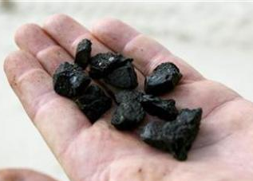
Tar balls
Discrete, and usually pliable, globules of weathered oil, ranging from oil to highly emulsified with varying amount of debris and/or sediment.
Source: Bonn
CGPRT(W) : Ensuring Clean Seas and Coasts in Western Region ……

Slide 50
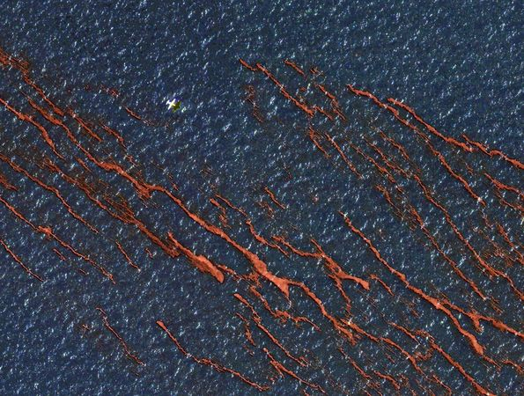
Windrows
Streaks of oil that line up in the direction of the wind.
The lines are roughly parallel to the wind direction, and the windier it is, the further apart the lines tend to form very early in a spill where the wind is 6 knots or greater.
Source: Bonn
CGPRT(W) : Ensuring Clean Seas and Coasts in Western Region ……

Slide 51
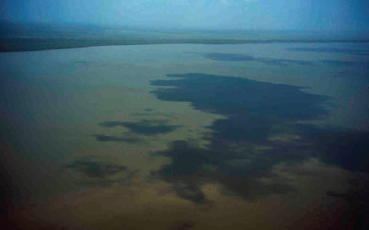
Oil Look Alike’ Phenomena
Cloud shadow
Source: NOAA
CGPRT(W) : Ensuring Clean Seas and Coasts in Western Region ……

Slide 52
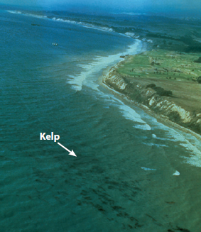
Oil ‘Look Alike’ Phenomena
Underwater growth of kelp resembling patches of black oil.
Altitude 250 m.
Source: NOAA
CGPRT(W) : Ensuring Clean Seas and Coasts in Western Region ……

Slide 53
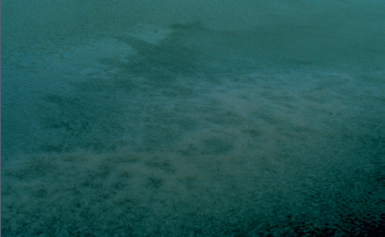
Oil Look Alike’ Phenomena
Jellyfish from 15 m taken by helicopter.
Source: NOAA
CGPRT(W) : Ensuring Clean Seas and Coasts in Western Region ……

Slide 54
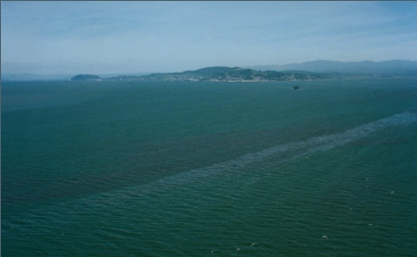
Oil Look Alike’ Phenomena
Algae blooms
Source: NOAA
CGPRT(W) : Ensuring Clean Seas and Coasts in Western Region ……

Slide 55
Any questions?
CGPRT(W) : Ensuring Clean Seas and Coasts in Western Region ……

